Slide 1
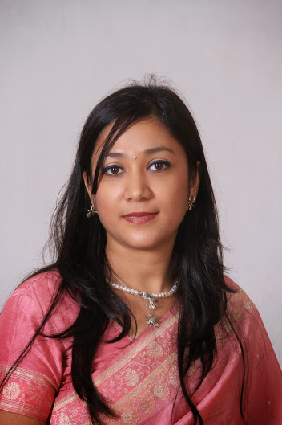
Dr. Priyanka Sutariya M.D, A.M, D.V.D, M.B.B.S
An expert in advanced skin care, lasers and surgical dermatology since last 18 yrs+
*Founder & Director : SKIN EXPERTS clinic
*Ex.Hon Secretary IADVL GSB 2017-18 and winner of best Branch Award for administration and activities.
*Ex. Vice President IADVL GSB 2018-19
*Jt. Sec @ Rotary club of Rajkot Greater
*Executive Committee Member in IADVL GUJ-gsb,IMA
*Organising Jt Secretary ASCICON 2018
*Organising Jt Secretary CDSI Mumbai 2019
*Invited faculty at state and national conference.,
Regular speaker on Radio, TV, FB etc
*Professional Life Memberships: IADVL,IWDA,IMA , ASCI ,CDSI .
*work Experience :consultant with APOLLO HSP , VLCC, MANIPAL HSP GROUP, Wockhardt Hsp, Gokul.
Special Areas of Interest:
Thread Lift and Fluid Facial contouring
Prp and Fat Transplant

